Slide 1
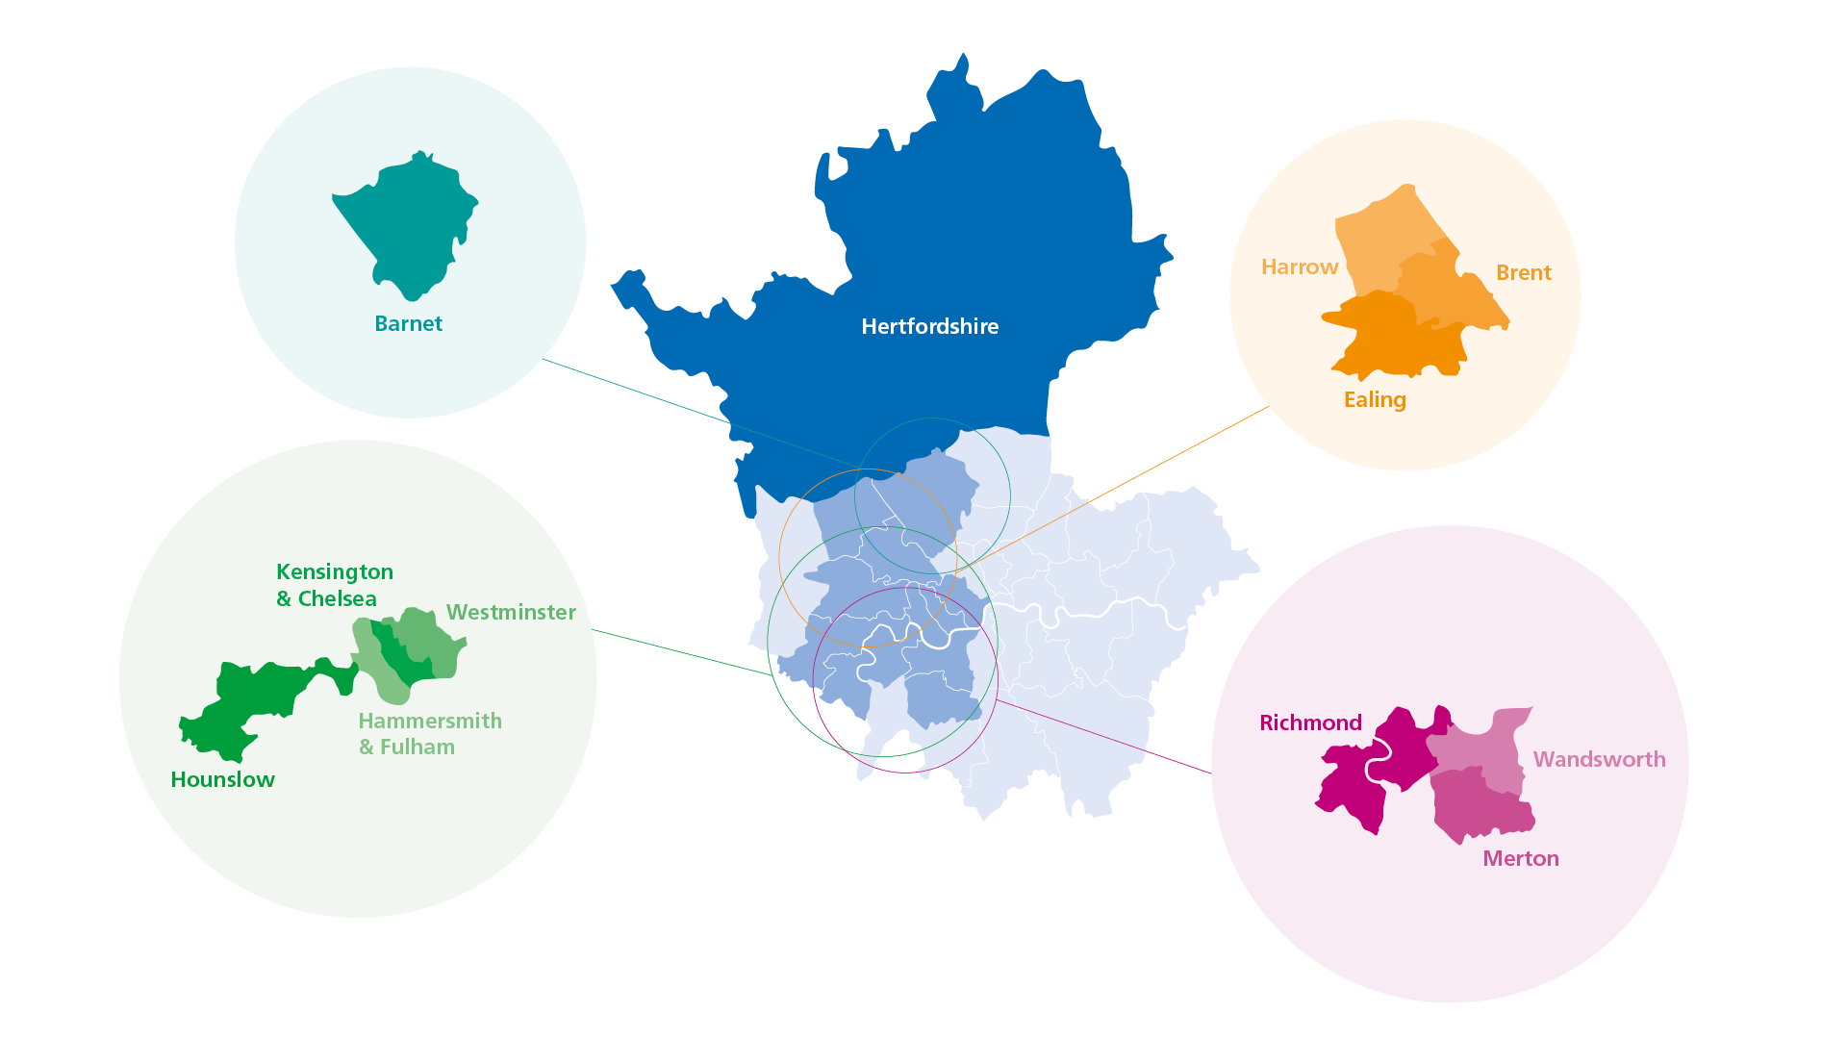
CQC Inspection overview
CLCH Community Nursing (Harrow): 19-26 October 2022

Slide 2
Inspection scope
Community Nursing teams in Harrow (all 3 localities)
Focused inspection on the ‘Safe’ domain
To review how improvements had been implemented following an incident in 2021 where a member of staff did not follow the correct procedures.
36 hrs notice provided
Visited two major staff bases
Also spoke to staff in the Harrow Tissue Viability, Podiatry and Rapid Response services

Slide 3
Inspection content
Staff (x25) at all levels in all localities interviewed
Focus groups held with nurses
Observed care provided to patients at home (x3)
Attended handover meetings and Quality Forum
Patient records (x19) reviewed
Staffing, Vacancies and Caseloads reviewed
Policies and procedures reviewed
Training records reviewed
Cleaning records reviewed
Data requests (x20) submitted after the inspection

Slide 4
Positive findings
Statutory and mandatory training uptake was high
Staff were trained how to protect patients from abuse
Infection risk was managed well and appropriate controls were in place
Clinical waste was managed well by staff
Staff took precautions and actions to protect themselves and patients
Medicine storage and prescription systems/processes were in place
Staff knew how and when to report patient safety incidents
Managers investigated incidents and shared lessons learned
When things went wrong staff apologised and gave suitable support
Actions from patient safety alerts were implemented and monitored

Slide 5
Areas for Improvement
The service did not have enough nursing staff
All locality teams had high vacancies which put staff under pressure [CQC noted that staffing levels had recently been increased and that there was an active recruitment campaign]
Records not always completed with enough detail
Some handover meetings were brief and lacking in detail.
Lack of leadership oversight on a case of neglect [which should have been reported to the local authority]
Audits and supervised visits were not occurring regularly
Capacity decisions were not consistently documented
Referrals for potential neglect not always made to the local authority

Slide 6
Improvements identified
CQC set the Trust two actions that it ‘must do’ to improve and three actions that it ‘should do’ to improve. Action plans have been created to achieve the improvements required.
Must Do | Should Do
ensure that robust processes and systems are in place to safely meet the needs of the patients | ensure that all handovers include all necessary key information to keep patients safe.
ensure that clinical documentation is completed in sufficient detail in the Harrow community nursing teams | ensure that formal assessments of patients capacity are appropriately recorded.
 | ensure staff report safeguarding concerns to the local authority when they are required to do so.

Slide 7
Inspection outcome
The rating in the ‘Safe’ domain for Community health services for adults has changed from ‘Good’ to ‘Requires Improvement’
The overall rating for the core service remains ‘Good’
The overall rating for the Trust remains ‘Good’
The full report can be viewed at: https://www.cqc.org.uk/provider/RYX/inspection-summary#chsadults

Slide 8
CLCH Outer North West Division
Jackie Allain
Acting Director of Operations
j.allain@nhs.net
Patrick Laffey
Deputy Director of Operations
patrick.laffey@nhs.net
Sam Howard
Divisional Director of Nursing & Therapies
samantha.howard@nhs.net

